Slide 1

Disease Prediction System
Project Title
DATA SCIENCE (24AD3107) Project Review-1
Date& Time
 | Under the Guidance of Ms.B.Prathusha Assistant Professor, Department of Computer Science and Engineering, KLH CSE Bowrampet Campus
Team Members Name L.Ishitha T.Siri Ch.Varshini Roll Number 2420030041 2420030390 2420030391

Slide 2

Outline of Project Work
Focus
Introduction
Literature Survey
Challenges
Research Objectives
Conclusion & Future Work
References
Publications Details

Slide 3
Introduction
Healthcare risk assessment traditionally relies on the analysis of individual clinical parameters such as blood pressure, glucose levels, BMI, and other medical indicators. However, a person's health is influenced not only by clinical factors but also by demographic and lifestyle factors such as age, physical activity, and sleep patterns.
With the increasing availability of healthcare datasets, Machine Learning can be used to identify complex patterns among these factors and estimate an individual's risk of developing different health conditions.
Our project proposes a Machine Learning-based multi-health risk prediction system that brings together clinical, demographic, and lifestyle information to provide an early risk assessment for multiple health conditions, including heart disease, diabetes, hypertension, sleep-related health risks, hair health, and obesity-related risks.
The system generates an estimated risk percentage and risk category, helping users understand their potential health risks in a simple and accessible manner.

Slide 4
Problem Statement
Many individuals have access to health-related information such as blood pressure, glucose levels, BMI, sleep duration, and other lifestyle indicators, but interpreting these parameters together to understand overall health risk can be difficult.
Existing prediction approaches are often developed for specific diseases independently, requiring separate models or applications for different health conditions. In addition, lifestyle parameters are not consistently incorporated into health-risk assessment, even though they can provide important contextual information.

Slide 5
Objectives
Develop an ML-based multi-disease prediction system.
Predict Heart Disease and Diabetes.
Analyze Hypertension, Sleep Health, Hair Health and Obesity.
Include clinical and lifestyle parameters.
Consider sleeping hours.
Generate risk percentage and risk level.
Compare multiple ML algorithms.
Evaluate model performance.

Slide 6
Problem Gap Identification
Disease-specific prediction
Many existing Machine Learning studies focus on predicting a single condition, such as diabetes or heart disease, rather than providing a broader multi-health risk assessment.
2. Limited integration of lifestyle factors
Clinical parameters are commonly used for prediction, while lifestyle-related factors such as sleep duration and daily habits may not be consistently incorporated.
3. Fragmented healthcare risk assessment
Different health conditions often require separate datasets, models, and prediction systems, making the overall assessment less convenient for users.
4. Limited user-oriented risk interpretation
Some prediction systems primarily provide a predicted class or outcome, without presenting the result as an understandable risk percentage and risk category.
5. Limited integration of prediction and guidance
There is a gap between generating a Machine Learning prediction and presenting the result in a user-friendly form with general health guidance.

Slide 7
Literature Survey
Authors | Title of the Paper | Methodology | Inferences | Limitation/Future work
Scoping review | Diabetes | Dt,lr.rf,svm | Ml used for risk prediction | Methods vary
Mao et al | A Survey on Machine Learning Techniques for Heart Disease Prediction | Reviewed 68 studies using RF, SVM, KNN, DT, LR and NB | ML techniques show strong potential for heart-disease prediction; RF and LR showed strong performance across reviewed studies | Results vary with datasets, preprocessing and validation methods
A Scoping Review | AI-Based Methods for Diabetes Risk Prediction | Reviewed AI/ML approaches for diabetes-risk prediction | Decision Trees and Logistic Regression were frequently used; RF, SVM, NB and KNN were also applied | Different datasets and methodologies make direct comparison difficult

Slide 8
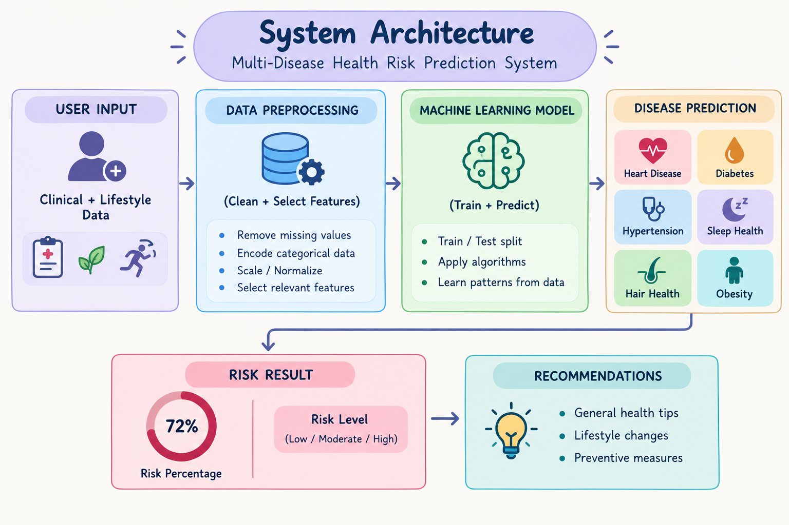

Slide 9
Feasibility
Technical Feasibility
The project can be implemented using:
Python
Pandas
NumPy
Scikit-learn
Matplotlib
Streamlit
Healthcare datasets
Jupyter Notebook / Google Colab
Dataset Feasibility
Suitable datasets will be collected for the different prediction tasks.
Each health condition will use relevant features and appropriate datasets rather than assuming that one dataset can predict every condition.

Slide 10
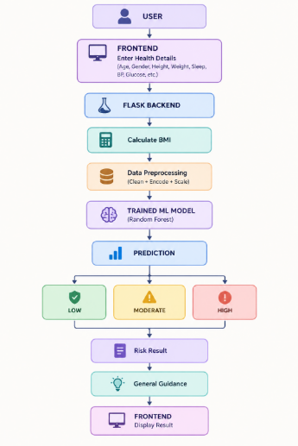
Work flow

Slide 11
Innovation, Creativity, and Novelty
Innovation & Novelty
Multi-disease health-risk prediction.
Combines clinical + lifestyle data.
Includes sleep duration and hair health.
Provides risk percentage and risk category.
Generates general health recommendations.
Compares multiple ML algorithms.
Uses multiple evaluation metrics.

Slide 12
Feasibility and Project Plan
TIMELINE CHART FOR EACH PHASE OF YOUR PROJECT SHOULD BE THERE AFTER EXPLANATION
Phase | Work
1 | Dataset Collection
2 | Preprocessing
3 | Feature Selection
4 | Model Development
5 | Model Training
6 | Evaluation
7 | Model Comparison
8 | Risk & Recommendation
9 | Documentation

Slide 13
Conclusion and future scope
Conclusion
Developed a framework for multi-health risk prediction.
Covers Heart Disease, Diabetes, Hypertension, Sleep, Hair Health and Obesity.
Provides risk percentage and risk category.
Gives general health recommendations.
Compares multiple ML algorithms.
Future Work
Add more diseases.
Use larger datasets.
Improve model performance.
Add Explainable AI.
Develop web/mobile application.
Integrate wearable health data.

